Slide 1
Graph-Based Detection
of Cooperative Dark Fleets
20-Minute Presentation
[Your Name] • February 2026

Slide 2
Agenda
1. Introduction & Motivation (3 min)
2. Data Pipeline (3 min)
3. Methods (5 min)
4. Results & Validation (5 min)
5. Case Studies (3 min)
6. Limitations & Conclusion (1 min)

Slide 3
1. Motivation
IUU fishing costs billions
Key pattern: vessel coordination at sea
• Transshipment
• Shared fishing grounds
• Rendezvous with dark vessels
ZERO labeled pairs → Unsupervised approach

Slide 4
2. Data Pipeline
2.38 billion AIS records (2012–2019)
SST coverage: 97.5%
Pipeline: Chunked merge → Year split → SST lookup → QC → Temporal graph
Edge = vessels < 10 km same day (876 daily snapshots)

Slide 5
3. Methods – Graph & TGCN
Nodes = MMSI (hundreds of thousands)
Temporal node features: interactions, partners, last seen, mean gap
TGCN = Graph Conv + GRU
Score = dot-product of embeddings

Slide 6
3. Methods – Evaluation
Strict time split (past → future)
5-fold rolling-window CV (50%–90% train)
Metrics: ROC AUC + Average Precision
3 random seeds

Slide 7
4. Results – Performance
Full-coverage (1500 buckets): ≈ 0.78
Capped graph: ≈ 0.95
5-fold CV: 0.927 ± 0.067
Temporal features + TGCN clearly outperform static baselines

Slide 8
4. Results – Validation
Top-1000 candidates ranked
Multi-threshold check:
• 25 km ±1 day → 8 pairs
• 50 km ±3 days → 11 pairs
• 100 km ±7 days → 14 pairs
Filters "same region" from real close encounters

Slide 9
Understanding the Numbers
Proximity days (e.g. 102) = days we found the pair within 25 km in GPS data
Candidate score (e.g. 15.92) = model's confidence; higher = stronger
These appear on the next slides.

Slide 10
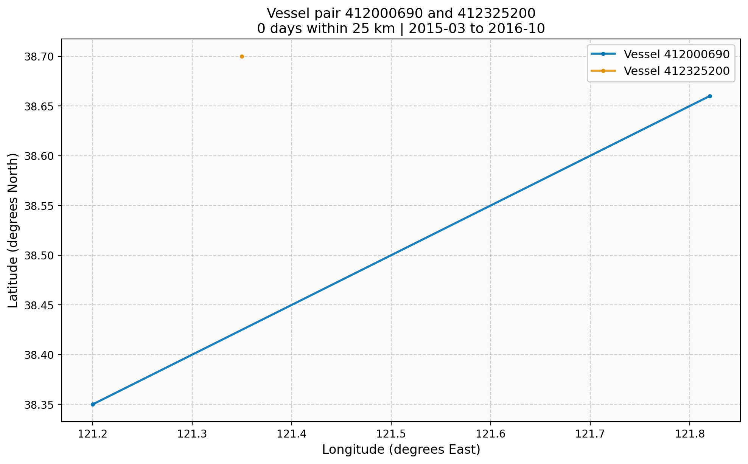
Case Study 1 – Strongest Candidate
412000690 ↔ 412325200
Score: 15.92
102 days within 25 km (±1 day)
410 days within 50 km (±3 days)
1,568 days within 100 km (±7 days)
Mean distance ~135–139 km
Multi-year repeated close encounters
→ Highest-confidence cooperative candidate

Slide 11
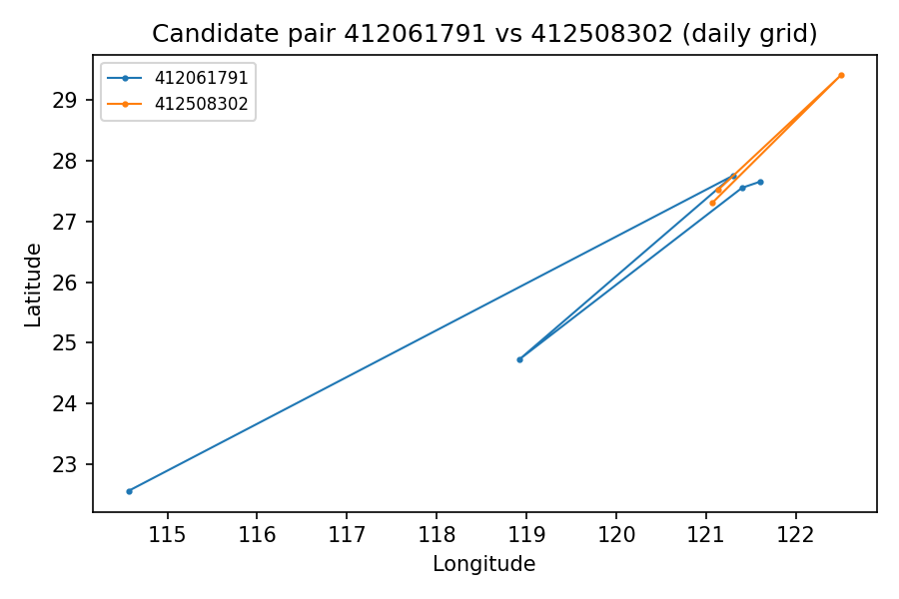
Case Study 2 – Moderate Evidence
412061791 ↔ 412508302
Score: 15.81
8 days within 25 km (±1 day)
88 days within 50 km (±3 days)
378 days within 100 km (±7 days)
Intermittent close proximity
Possible transshipment or shared grounds
→ Solid secondary candidate

Slide 12
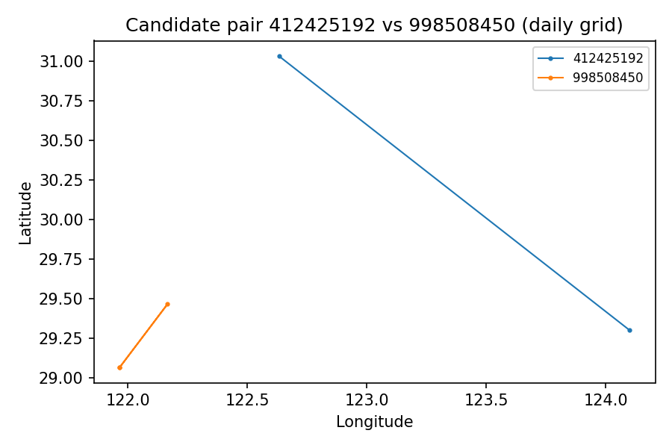
Case Study 3 – Occasional Coordination
412425192 ↔ 998508450
Score: 14.86
9 days within 25 km (±1 day)
20 days within 50 km (±3 days)
53 days within 100 km (±7 days)
Fewer total encounters
Possible occasional meetings or shared region
→ Useful for geographic diversity

Slide 13
Case Study 4 – Regional Overlap (Contrast)
978925333 ↔ 415131223
Score: 14.80
2 days within 25 km (±1 day)
12 days within 50 km (±3 days)
864 days within 100 km (±7 days)
Very few close meetings
Likely same fishing grounds / corridor
→ Shows value of multi-threshold validation

Slide 14
6. Limitations
Daily grid-cell resolution (fine events blurred)
No ground-truth labels (proximity = proxy)
Results depend on thresholds & time period

Slide 15
Conclusion & Future Work
Working, reproducible pipeline
Strongest candidate ready for investigation
Future:
• Sub-daily resolution
• Metadata (flag, gear, ownership)
• Supervised learning when labels available
Thank you! Questions?

